Slide 1
Application Programming Interfaces (APIs)
Yotam Shmargad
Assistant Professor
University of Arizona

Slide 2
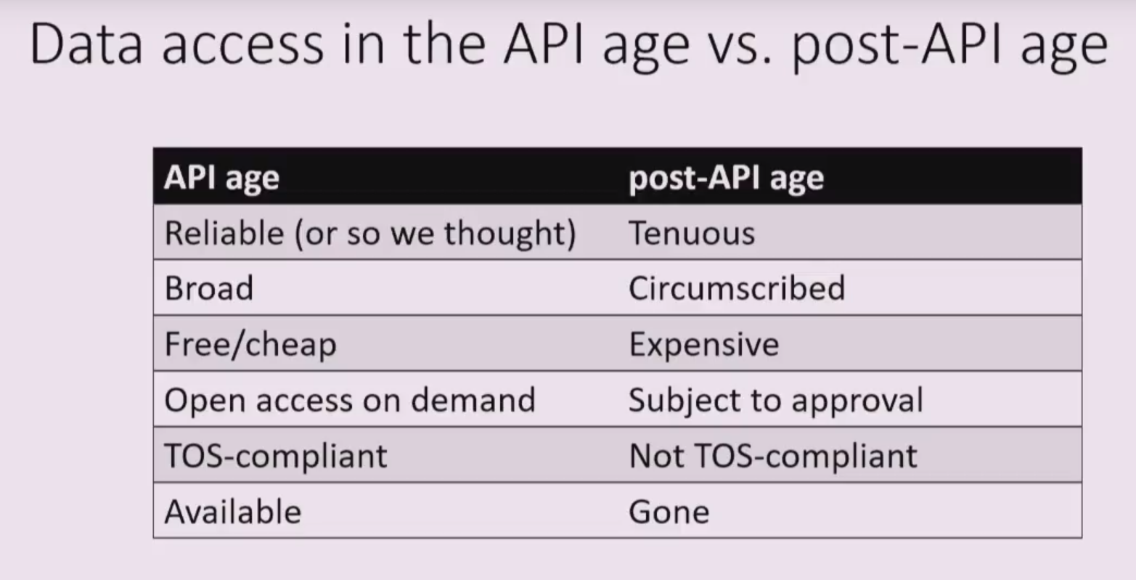
As Deen Freelon said in his recent 2018 SICSS talk, we’re quickly entering a “post-API age”
Full video: https://www.youtube.com/watch?v=uHSCRDoJ0yM

Slide 3
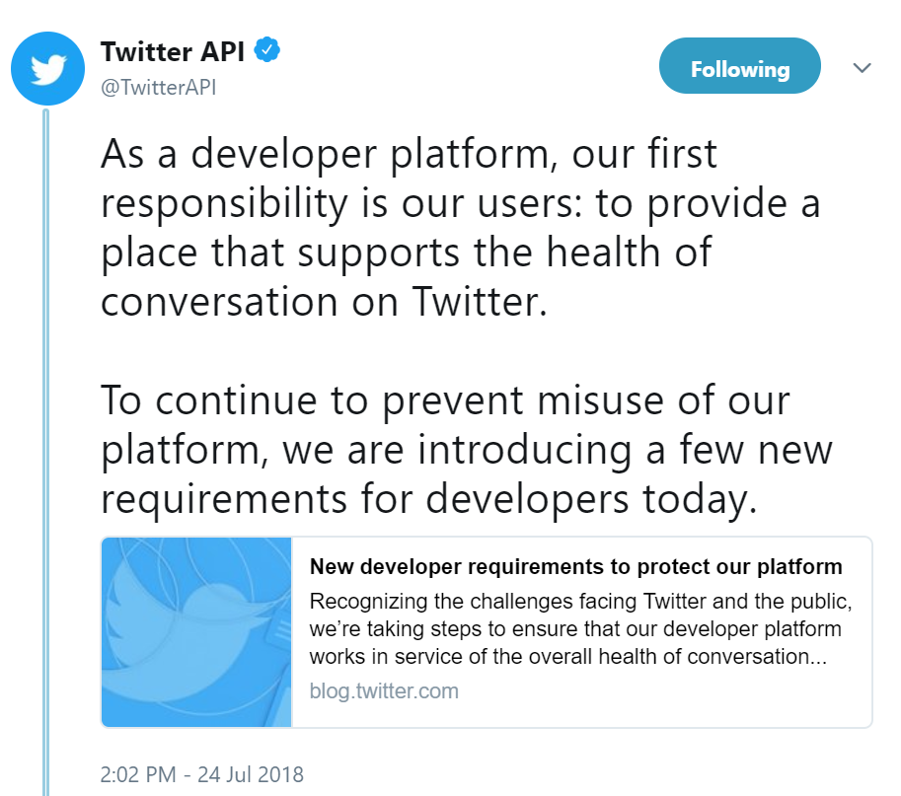
In the past, Twitter allowed anyone to use its API – recently, they added a developer approval process

Slide 4
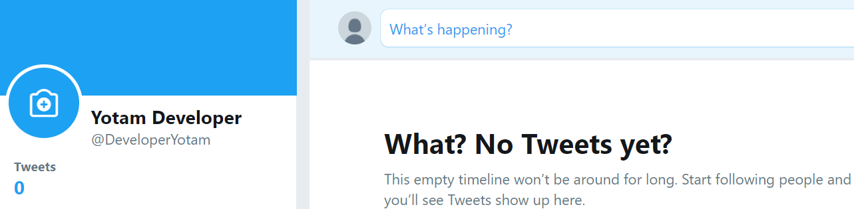
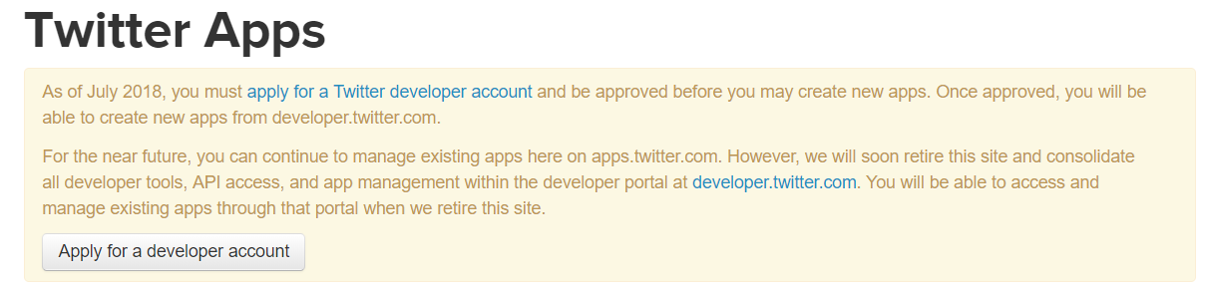
To understand what it’s like to apply for API access as a new developer, I created a new Twitter account
www.twitter.com
apps.twitter.com

Slide 5
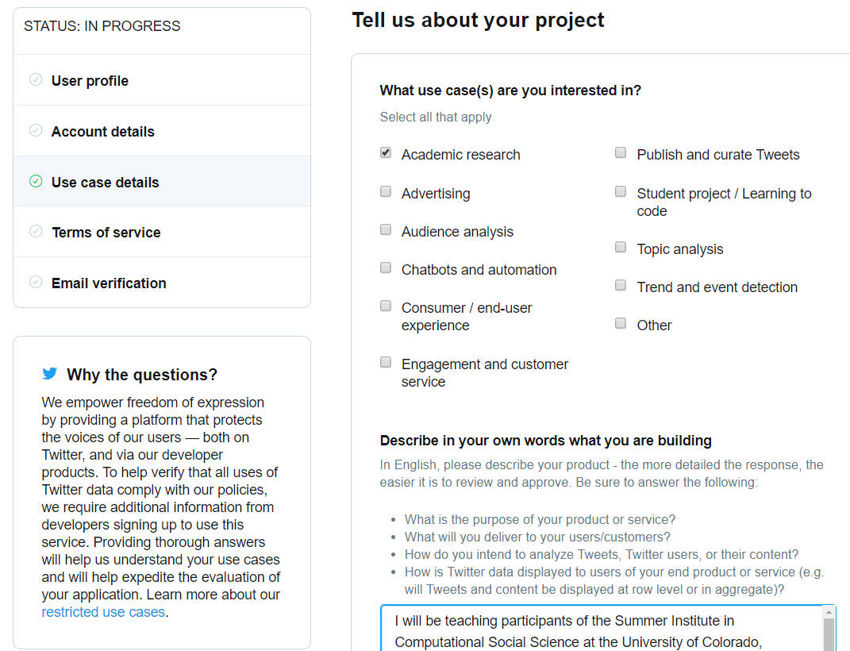
I went through Twitter’s significantly more involved process a week ago and have still not heard back…
?

Slide 6
I encourage you all to go through Twitter’s process if you do not already have a developer account
Steps:
Go to www.twitter.com and sign up for a Twitter account: add a phone # and verify your email address
Go to apps.twitter.com and apply for a developer account: check ‘Student project/learning to code’
Wait for approval…
Register a new app: Chris Bail has a good tutorial https://compsocialscience.github.io/summer-institute/2018/materials/day2-digital-trace-data/apis/rmarkdown/SICSS_APIs_markdown.html

Slide 7
Twitter’s new approval process has made it difficult to teach students how to use the API in real time
Alternatives
Have students go through Twitter’s new developer application process well ahead of time
Unfortunately, there was not enough time to have Boulder SICSS participants (you!) go through the approval process
Teach students how to use Twitter’s API using files that are generated ahead of time (through an existing developer account)
This is the alternative that I will attempt today

Slide 8
I’ll first discuss a couple of technical issues when using APIs, then a specific application with Twitter
The plan
Discuss a couple of technical issues when using APIs
Talk about the details of our specific application: Constructing Ego Networks from Retweets
Go through the code!
Those who already have a developer account can follow along using Twitter’s API
Those without a developer account can download files from my Github repository: github.com/thesickish/BoulderSICSS

Slide 9
There are two issues that often come up when using APIs
Issues and solutions
Companies often impose limits on how much data one can collect from their servers in a single session
- On Twitter, these limits refresh every 15 minutes
→ Tell python to sleep for 15 minutes if a limit is reached
Errors can arise when content or user accounts have been deleted
- This can disrupt our code so that python stops working
→ Tell python to skip content/users that no longer exist
Next: Constructing Ego Networks from Retweets

Slide 10

Twitter has become a central platform for anyone hoping to get information out to the public
A tweet
Retweets = # of times tweet was shared directly

Slide 11
We can get a sense of how much exposure tweets are receiving by analyzing their retweets
Advantages of analyzing retweets
Measure dissemination: one user’s decision to share another user’s message
Timely: since retweets are tied to specific posts, we can analyze a time period of our choosing
Relatively rare: users tend to have fewer retweets than followers, so we can analyze popular accounts
Generate networks: We can know if two retweeters of a user’s tweets retweet each other

Slide 12
Today, you will learn how to collect and organize Twitter data to build a network from retweets
Outline
Create a Twitter developer account
Use the Tweepy package (in python) to collect tweet and retweeter data
Organize data and build a social network using the networkx package (in python)
Visualize the network

Slide 13

We will first collect an account’s tweets, retweeters, their tweets, and their retweeters
Data we will collect
Tweet
Tweet
Tweet
Tweet
Tweet
Tweet
Tweet
Tweet
Tweet
Tweet
retweeters

Slide 14
We will then use the data to build an ego network, where links capture retweets between users
_{alter}
Links in this network have weights – the number of one user’s tweets that another user has retweeted
2
3
_{alter}
1
ego
Since we know if retweeters retweeted each other’s tweets, we can calculate measures of local redundancy (or density)
_{alter}
10
_{alter}

Slide 15
I used this method to analyze Twitter accounts of candidates in the 2016 U.S. congressional elections
Final dataset
Accounts of more than 400 candidates
Over 25,000 candidate tweets
Over 190,000 retweeters of candidate tweets
Almost 900,000 retweeter tweets
About 1.3 million retweeter retweeters
...
Campaign donations and election outcomes
(more at my talk this afternoon!)

